Slide 1

Construction Site Management Platform
DBMS Project-Based Learning – Review 3
PRESENTED BY
Mohammed Ali
Roll No. 25WU0102161

Slide 2
From Database to Working Application
Key Capabilities
Application Architecture
Project and site management
Procurement and delivery tracking
Material stock management
Work package and progress tracking
Contractor billing and payment management
Reports and database-driven insights
CRUD operations with validation
User
▼
BUILDREC UI
▼
React + TypeScript
▼
Node.js + Express API
▼
MySQL Database
Database Design
Database Implementation
BUILDREC Application
Working UI + CRUD + Reports
BUILDREC | DBMS Project-Based Learning – Review 3
2

Slide 3
Technology & Implementation
DATABASE
BACKEND
FRONTEND
CONNECTIVITY
MySQL 8.0+
Node.js + Express + TypeScript
React + TypeScript + Vite
mysql2 / REST API
Implementation Highlights
Business Logic & UI
15 normalized database tables
Primary and foreign key constraints
NOT NULL, CHECK and referential integrity
Database triggers for business-rule enforcement
Analytical SQL views for reporting
Responsive UI for desktop, tablet and mobile
BUILDREC | DBMS Project-Based Learning – Review 3
3

Slide 4
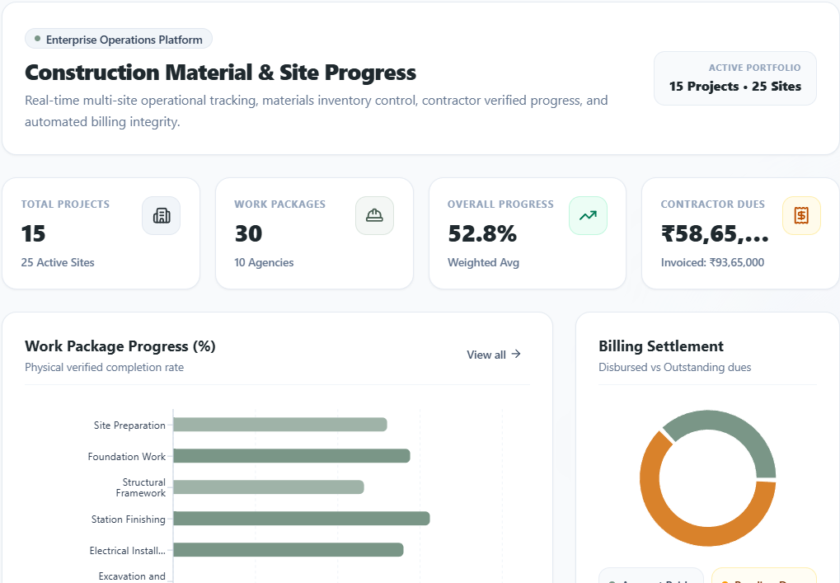
BUILDREC Dashboard
Dashboard Shows
Active Projects
Registered Sites
Live Material Stock
Overall Progress
Total Billed vs. Paid
Pending Contractor Payments
Material Consumption
Project-wise Financial Overview
Recent Activity
BUILDREC | DBMS Project-Based Learning – Review 3
4

Slide 5
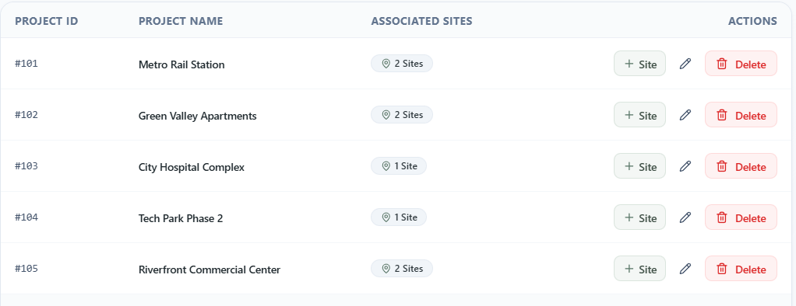
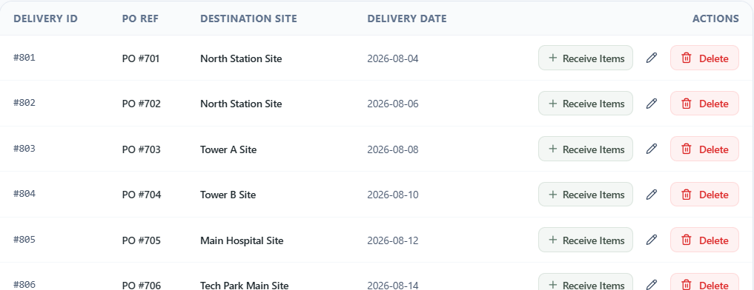
Projects, Sites & Procurement
Projects & Sites
Procurement & Deliveries
View and search project records
Manage construction sites under projects
Add new projects and sites
Filter sites by project
Maintain project-site relationships
Manage suppliers
Create purchase orders
Record site deliveries
Add delivery items and quantities
Track incoming materials
BUILDREC | DBMS Project-Based Learning – Review 3
5

Slide 6
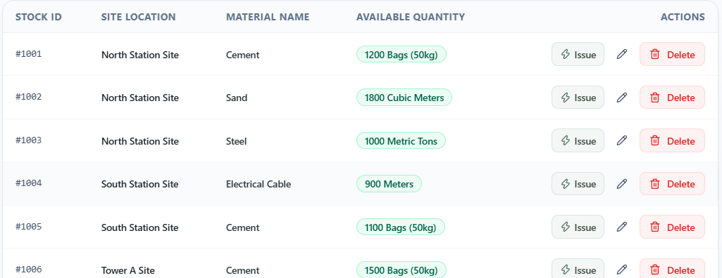
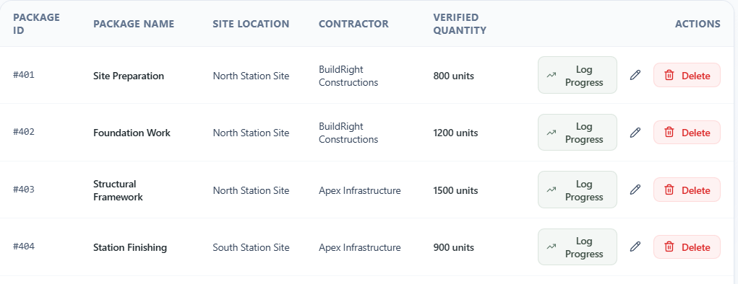
Materials, Stock & Progress
Materials & Site Stock
Work Packages & Progress
Manage material catalogue
View stock by site and material
Track available quantities
Issue materials to work packages
Enforce stock availability
View work packages and contractors
Log progress entries
Assign labour teams
Track completion percentage
Validate progress between 0–100%
BUILDREC | DBMS Project-Based Learning – Review 3
6

Slide 7
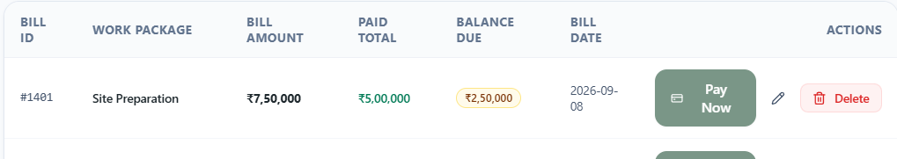
Billing & Payments
Contractor Billing
Payments
Database Validation
View contractor bills
Track billed quantities
Verify work-package progress
Control invoice creation
Track outstanding balances
Process payments against bills
Track payment history
Prevent payments exceeding bill
Auto-reflect settlement status
Billing requires verified progress
Payment cannot exceed billed amount
Triggers enforce financial rules
BUILDREC | DBMS Project-Based Learning – Review 3
7

Slide 8
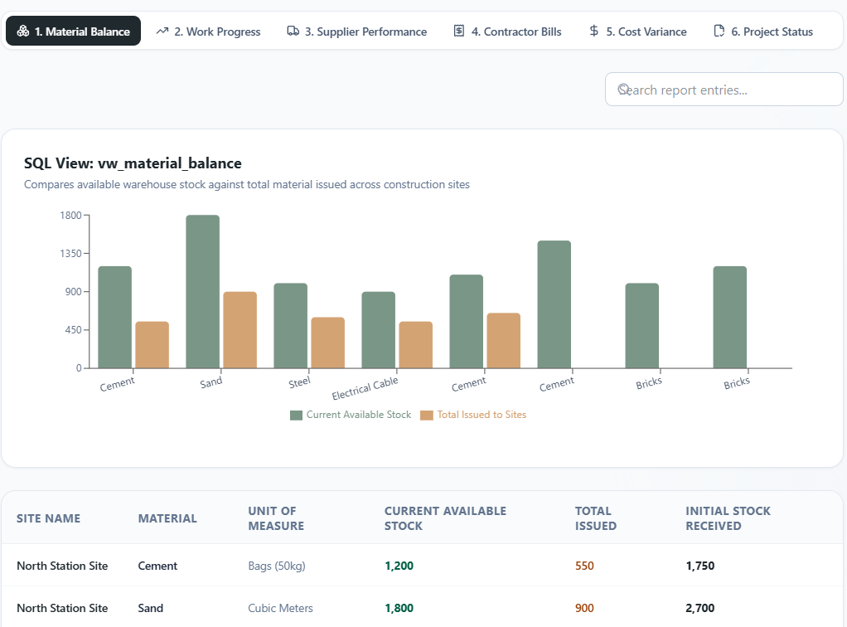
Database-Driven Reports
Reports
Material Balance
Work Progress
Supplier Performance
Contractor Bills & Balances
Project Cost Variance · Project Status
Analytics
Material availability and consumption
Work-package completion
Supplier delivery performance
Contractor billing and payments
Project financial summaries
BUILDREC | DBMS Project-Based Learning – Review 3
8

Slide 9
CRUD & Database Validation
INSERT
Add a project / site / record
VIEW
Retrieve live database records
DELETE
Remove a record with confirmation
VERIFY IN MYSQL
Confirm in MySQL Workbench
CRUD Operations
Validation
Insert
View
Delete
Search
Progress outside 0–100% → Rejected
Material issue above stock → Rejected
Billed qty above verified work → Rejected
Invalid delivery date → Rejected
Payment above bill amount → Rejected
Foreign keys protect related records
BUILDREC | DBMS Project-Based Learning – Review 3
9

Slide 10
Conclusion & Future Scope
Conclusion
Future Scope
Centralized construction project data
Integrated material and site management
Progress and contractor tracking
Billing and payment management
CRUD operations with validation
Database-driven reports
Real-time application–database integration
Role-based authentication
Multi-user access control
Advanced project analytics
Mobile/PWA deployment
Cloud deployment
Automated alerts and notifications
Integration with BIM/site monitoring
BUILDREC converts the normalized database into a working site management application connected to MySQL.
Thank You
BUILDREC | DBMS Project-Based Learning – Review 3
10

